Slide 1

Corporate Governance MG 5326
Class 4
Shareholder and stakeholder relations

Slide 2
Objectives
Understand the legal rights of shareholders
Consider emerging responsibilities of shareholders
Understand the impact of shareholder activism
Understanding CSR
The Triple Bottom Line
Sustainability:Greentalk to greenwalk

Slide 3
Role of Shareholders in corporate governance
Friend or foe?
Do they have the same interests?
Returns
Time horizons
Control
How do you align their interests?
How important are other stakeholders?

Slide 4
Legal rights of shareholders (Canada/USA/UK….)
Right to attend and vote at shareholders meetings
Right to make shareholder proposals
Right to elect the directors
Right to appoint the auditors
Right to receive financial statements, auditor’s report and proxy circular
Right to information via disclosure documents
Right to vote with their feet if not happy

Slide 5
Other Stakeholders
Rating agencies
How are they assessing your governance practices
Impact on ratings
Consumer groups
Impact on shareholder proposals
Impact on business
Government
Impact on regulation
Impact on business – subsidies, tax protections
Impact on competitive structure (e.g. banks)
Employees
Impact on end product
Employee loyalty

Slide 6
Corporate Social Responsibility
The compliance issue:
Regulators looking for more disclosure of risks of environmental impact
Costs of ‘best practice compliance’
The governance issue:
Is the board really engaged?
Responding to a wider stakeholder group
Impact on short term performance

Slide 7
Can we continue to grow?
The numbers
Sale of goods +50% in 10 years
New consumption/production records set every year
All resources are non-renewable
3 billion live on less than $2/day
Population will increase by 50% by 2050
20% use 80% of resources

Slide 8
Can we continue to grow?
The numbers
Sale of goods +50% in 10 years
New consumption/production records set every year
All resources are non-renewable
3 billion live on less than $2/day
Population will increase by 50% by 2050
20% use 80% of resources

Slide 9
The issues
Climate change
CO2 is highest in 400,000 years
Extreme weather events
Insurance costs
Peak oil
Peak discovery in 1970
Peak production – today?
Demand growth by 40% by 2030

Slide 10
The triple bottom line: people, environment, economy
companies must embrace “purpose” in all they do. .
ensuring that their products contribute positively and responsibly to sustaining human civilisation.
obesity
operating in a way that approaches a “net-neutral” impact to the natural environment.
goal of a net-neutral impact on the environment
cherishing their people.
Looking after employees

Slide 11
Green accounting
Corporate accounting will get cleaner and greener—and perhaps even meaner.
companies will be more eager than ever to offer up environmental indicators to show their good citizenship.
green accounting is already starting to conform to one standard.
The Global Reporting Initiative
1,750 global companies expected to issue reports based on 2008 guidelines

Slide 12
Sustainability reporting
Global Reporting Initiative
Dow Jones Sustainability Index
FTSE4Good
UN Principles for Responsible Investment
ISO 14001 (environment)
SA 8000 (human rights)
ISO 2600 (social responsibility)
UN Global Compact

Slide 13
But, it’s a long road…
in most countries green accounting has few teeth.
America requires companies to report on their toxic waste
several European countries require reporting on matters like corporate energy usage.
US, the world’s great energy guzzler,
“sustainability reports” are voluntary.
One big problem is that most sustainability reports are not audited by outsiders (verification is especially rare in America).
This could change as investing in “sustainable companies” grows.
Environmentalists are putting pressure on SEC to require companies to disclose their carbon emissions, and quantify (for the benefit of shareholders) the possible impact of climate change on companies’ bottom lines

Slide 14
Greentalk….
Is thisthe real thing?
–‘“For us, as a company, the debate about whether man-made climate change is happening is over. The debate now is about what we can do about it. With fossil fuel use and CO2 levels continuing to grow fast, there is no time to lose.”
Jeroenvan derVeer, Chief Executive, Royal Dutch Shell

Slide 15
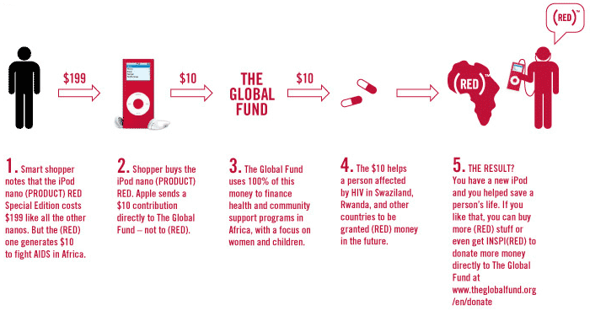
Greentalk Campaigns –Product RED (canArmani makea difference?)

Slide 16
Greenwalk…..
Promise: A high-level commitment by the company to responsible behaviour and sustainable development
"My test is that our children should look back at what I and Barclays did in 2007 and beyond, and be able to say 'they recognised the immensity of the challenge, they evaluated it sensibly and they were amongst the leaders who, by their actions and influence, really made a positive difference'. More than anything, I want my children to be able to look me in the eye and to say with conviction 'You played yourpart'.
John Varley, Group Chief Executive Barclay’sBank

Slide 17
The role of governance professionals
Key role is the implementation and oversight of effective governance processes
Culture shift from growth to sustainability
Focus on key tools
Accountability
Transparency
independence

Slide 18

Class 4 Assignment
Final paper of 4-6 pages
Select a company that is listed on a public securities exchange in your country or any other country of your choice.
Select a company that is listed on a public securities exchange in the UK, Canada or the United States.
You are the governance consultant for a major investment company that is thinking of investing a large amount in the company. Evaluate the governance practices of that company as disclosed in company materials provided to the regulators as well as any information obtained from other sources, and provide your recommendation as to whether an investment should be made in that company based on its governance and sustainability practices.
Be sure to list your sources. Papers may be scanned for plagiarism off the internet. Any evidence of plagiarism (copying without appropriate citation) will result in a Failure in the course. (30 marks)

